Slide 1
Gemini AI Chatbot Using API Key
Final Internship Evaluation Presentation
Data Science Internship Project
by
N AAMEER MOHAMED (GT25ON279823)
A.KARUPPAIAH (GT25OF0468)

Slide 2
Project Overview
The Gemini AI Chatbot Using API Key is an intelligent web-based chatbot application that uses Google's Gemini API to generate human-like responses to user queries.
The main goal of this project is to demonstrate how modern generative AI can be integrated into web applications to build smart conversational systems. Unlike traditional rule-based chatbots, this chatbot can understand a wide variety of questions and provide dynamic responses, making it suitable for applications such as customer support, education, and virtual assistants.

Slide 3
Problem Statement
Users need instant answers and conversational assistance.
Traditional rule-based chatbots provide limited responses.
Generative AI enables more natural and context-aware conversations.
Chatbots often fail to understand complex or unexpected user queries.
This project aims to build a smart chatbot that can be easily integrated into web applications.

Slide 4
Objectives
Integrate Gemini API with a frontend application.
Send user prompts to the API securely.
Display AI-generated responses in real time.
Create an easy-to-use chatbot interface.
To provide real-time, context-aware conversational assistance.
To design a simple and user-friendly chat interface using HTML, CSS, and JavaScript.
To create a scalable chatbot solution for education, customer support, and personal assistance.

Slide 5
Technologies Used
HTML – Structure of the chatbot interface
CSS – Styling and responsive design
JavaScript – Client-side logic and API calls
Gemini API – Generative AI responses
Visual Studio Code – Development environment

Slide 6
System Architecture
The user enters a question in the chatbot interface. JavaScript captures the input.
The frontend built with HTML, CSS, and JavaScript captures the input.
The input is validated and formatted as a prompt.
JavaScript sends the prompt to Google through the Gemini API using an API key.
The Gemini model processes the prompt and generates a response.
The response is returned in JSON format.
The chatbot displays the answer in the web interface in real time.

Slide 7
Project Modules
User Interface Module
Input Processing Module
API Communication Module
Response Rendering Module
Error Handling Module

Slide 8
Working Process
1. User types a question.
2. JavaScript validates the input.
3. Prompt is sent to Gemini API using API key.
4. Response is received in JSON format.
5. Answer is displayed in the chat box.

Slide 9
Advantages
Natural language understanding
Fast and accurate responses
Easy to integrate with websites
Scalable and customizable

Slide 10
Challenges and Solutions
API key security → Store securely and restrict usage.
Network failures → Added error handling.
Slow responses → Display loading indicator.

Slide 11
Future Enhancements
Voice input and speech output
Chat history storage
Multi-language support
User authentication

Slide 12
Conclusion
Successfully developed a functional AI chatbot using Gemini API.
Demonstrated frontend development and API integration skills.
Useful for customer support, education, and personal assistants.

Slide 13
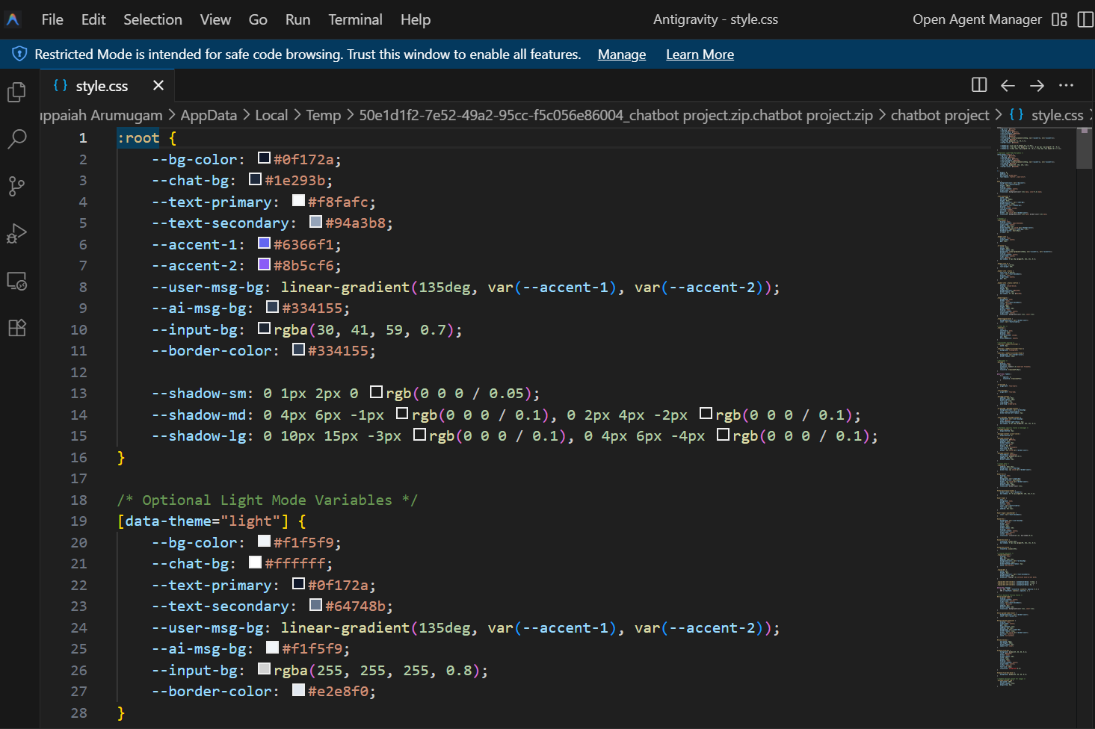
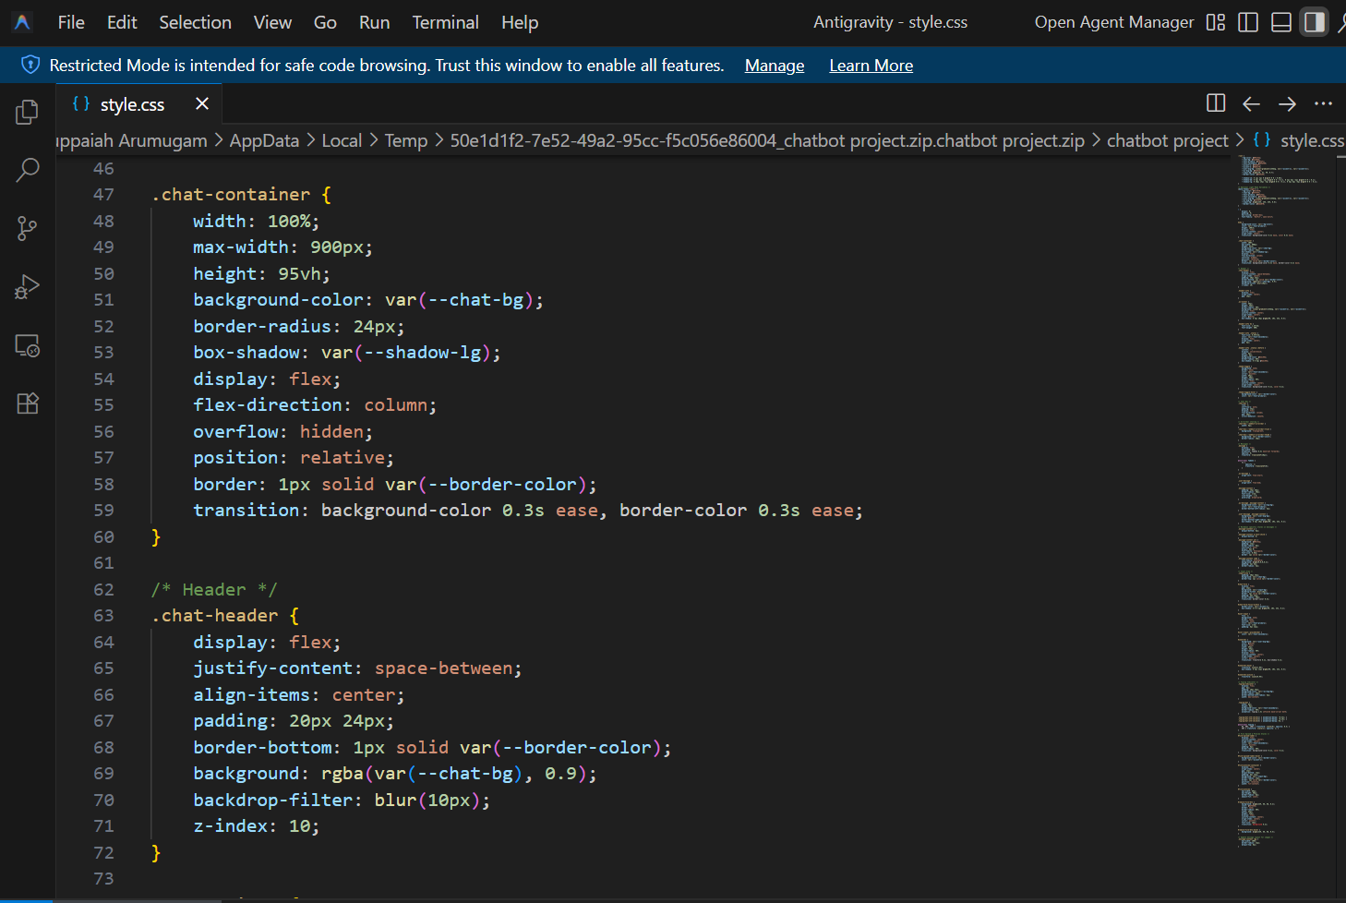
SAMPLE CODE :

Slide 14
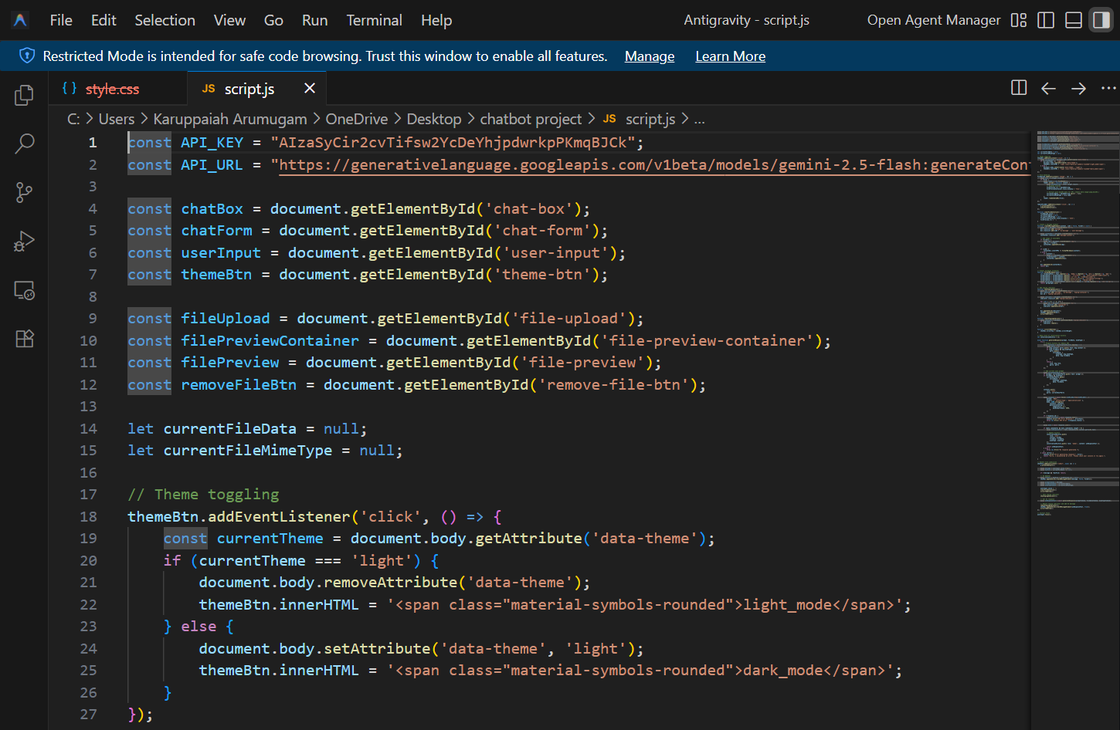
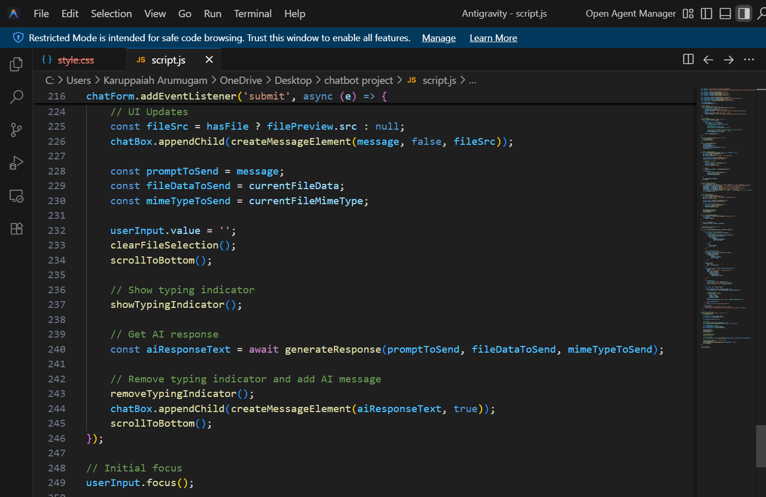
SAMPLE CODE :

Slide 15
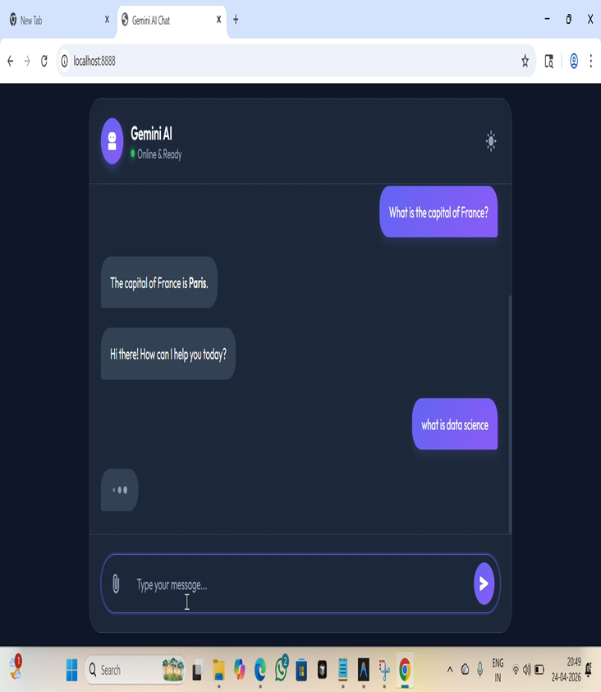
SCREENSHOTS :

Slide 16
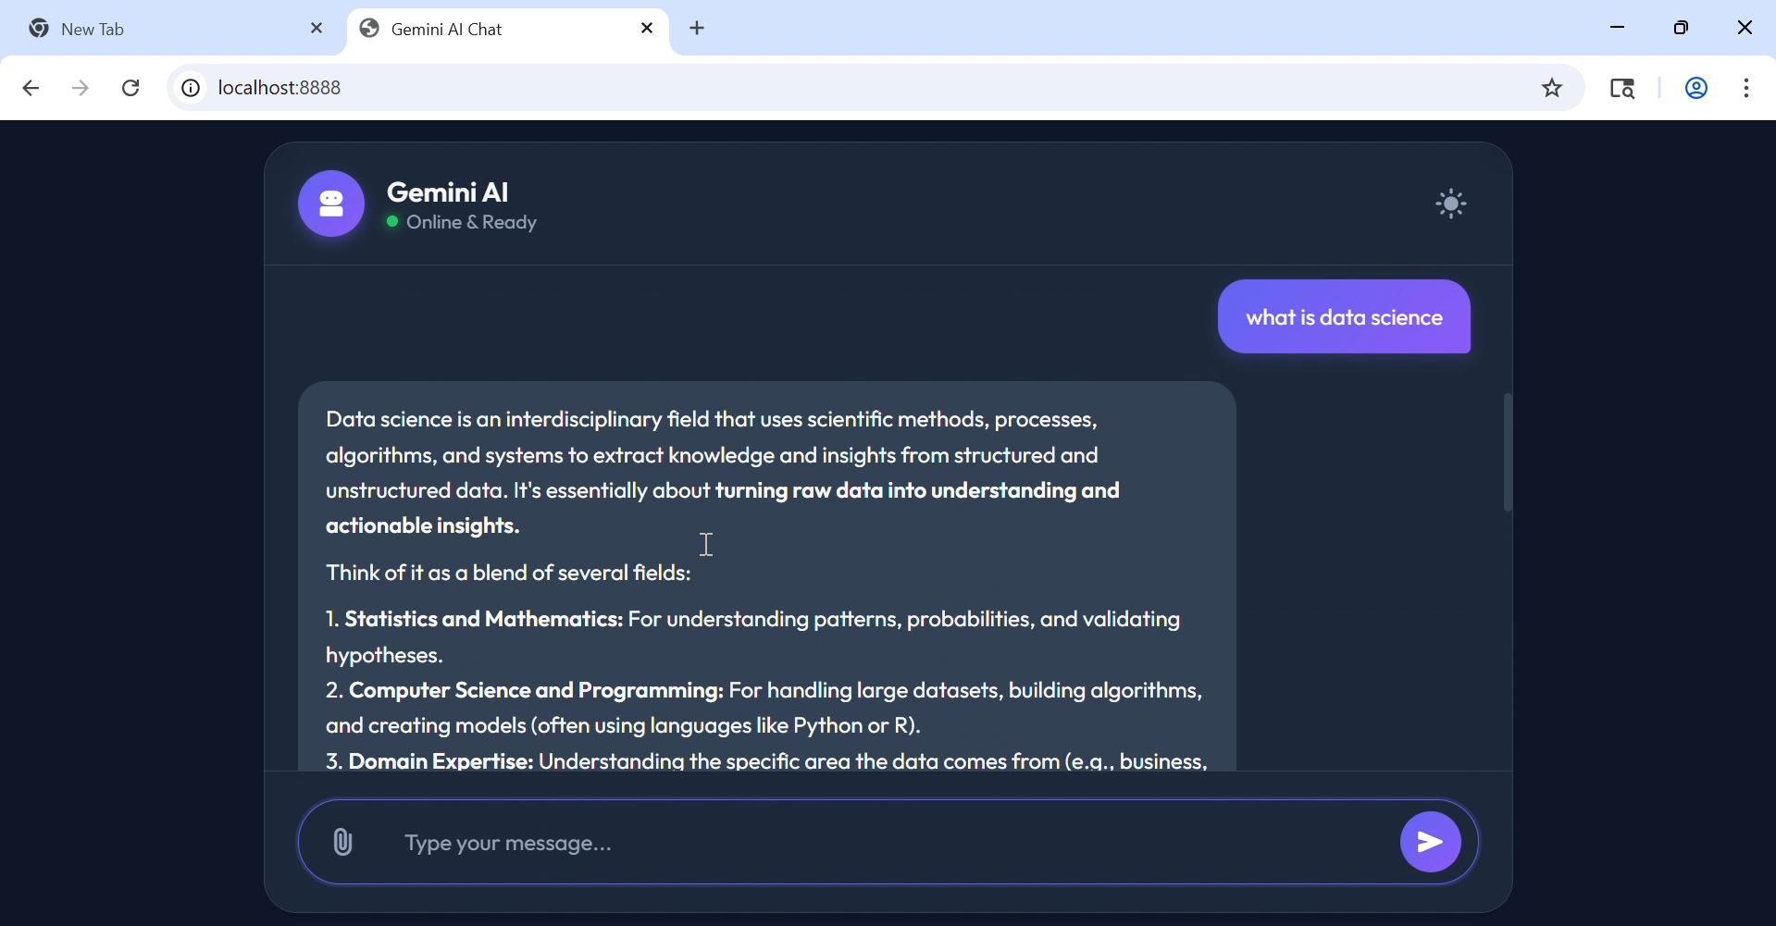
SCREENSHOTS :

Slide 17
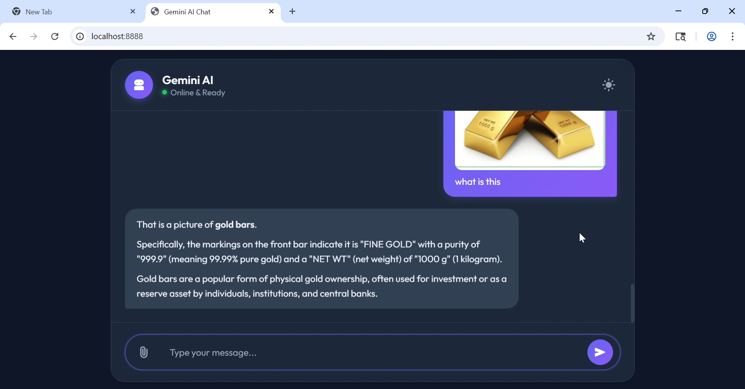
SCREENSHOTS :

Slide 18
THANK YOU

